Slide 1
CHANEL

Slide 2
Now and Forever: The Anatomy of a Bag

Slide 3
Brand Research
History
Chanel, a french luxury fashion and merchandise atelier, was founded by Gabrielle “Coco” Chanel in 1910
Chanel started as a hat retailer, but now features various products online and on-location such as clothing, handbags, shoes, jewelry, watches, eyewear, fragrance, makeup, and skincare
Chanel fashion went into American consciousness when Coco designed the costumes for films Tonight or Never (1931) and The Greeks Had a Word for Them (1932)
The invention of the “Little Black Dress” and women’s collarless jackets are credited to Chanel

Slide 4
Brand Identity
Mission Statement: "To be the Ultimate House of Luxury, defining style and creating desire, now and forever" (Chanel)
Chanel creates an iconic image of an everyday woman that values luxury, style, and desire
Branding an identity of now and forever timeless couture
The concept of timeless clothing and fashion preservation continues this mission of ageless pieces to keep for generations

Slide 5
Brand Analysis
Recent History
Chanel’s most iconic items: CHANEL N°5 PERFUME, The Classic Handbag, tweed suiting, and elegant pearl necklaces
In 1983, fashion icon Karl Lagerfeld became the Artistic Director of the house
Connection to celebrities like Jackie Kennedy, Marilyn Monroe, Keira Knightley, Nicole Kidman, and Kristen Stewart
Associations
Chanel branding and symbol is associated with ideals of wealth, luxury, and class, which can be seen in their mission statement and their slogan, "To be irreplaceable, one must be different." Chanel's vision conceptualizes the embodiment of women being elegant and classy while still standing out through timeless pieces of clothing and handbags.

Slide 6
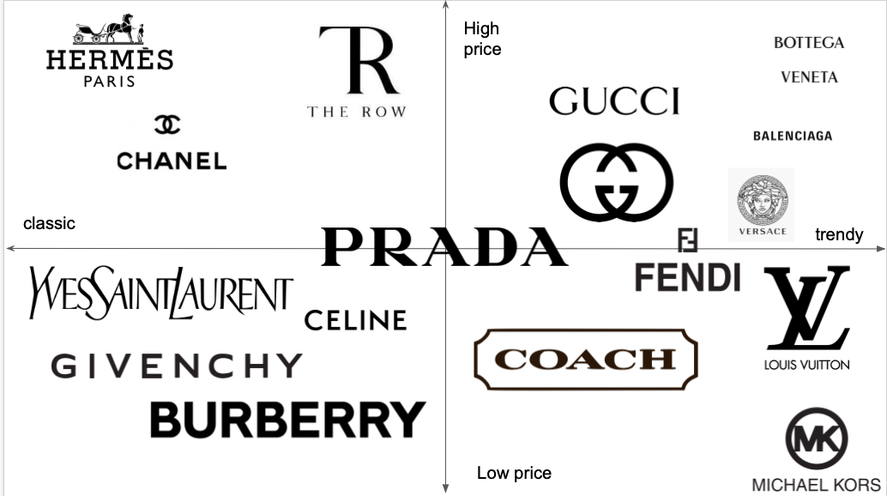
Competitive Analysis
Luxury Market – one of the two highest quality houses: Hermes and Chanel, the more affordable option within the highest-quality market
The parameter “classic or trendy” represents the timelessness of the product
With the move towards more sustainable fashion, trend-less, classic items are becoming more important
The classic Chanel look is connecting with consumers in a new way - Jackie Kennedy on the day her husband was assassinated vs. Olivia Rodrigo on her visit to the white house
Seared into the American conscious as an image of elegance. The idea of timeless glamour is synonymous with Chanel

Slide 7
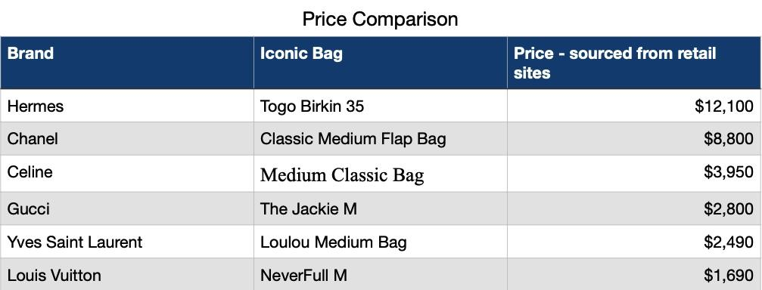
Competitive Analysis

Slide 8
Opportunity Analysis – First Thoughts
While Chanel occupies its place as the less expensive version of the highest quality pieces on the market, we thought:
We saw an opportunity to break into the GEN Z market by focusing on the classic fashion’s connection with vintage/sustainable clothing
Chanel has made the purchasing of clothing and their iconic handbags a strictly in-person experience, with no plans to change that any time soon – opportunity to break our in online retail
Societal shift toward buying less but better quality clothing to be more environmentally friendly – Chanel will last if you are willing to invest

Slide 9
FGI Report
What We Wanted to Figure Out
We interviewed people who shop in the luxury clothing market to find out:
Consumer understanding and associations
Buyer motivations – does resale potential or trendiness/classic-ness play a role
Competitor Awareness and Associations
Product Attribute and Pricing Awareness

Slide 10
What They Said and What We Learned
Chanel has a strong brand image and personality
Respondents frequently use words like "classic," "elegant," and "timeless."
Strong association with "French Style," which focuses on elegant, simple, and expertly crafted items
Most could remember and identify Chanel products like Chanel No. 5 perfume and The Classic Handbag. #2 associated the items with a location, a nice cocktail or dinner party.

Slide 11
What They Said and What We Learned
Core Motivations of Purchase
Association with influential people and high status
High quality items that are timeless = good investment because they will not go out of style
"Chanel doesn't need to do much to stay relevant because the look that it represents has been so present. Other brands need to reinvent and seek attention to stay relevant. You know when it’s Chanel"

Slide 12
What They Said and What We Learned
Points of Improvement
Compared to brands in the same category, Chanel took on an identity as older and less willing to push boundaries.
"if you're going to shell out the money for a designer item, you want the newest and hottest stuff. You wouldn't want last season's things for the price of something that is brand new” (4).
What We Were Wrong About
Group did not consider resale potential or appreciating value a buying motivator
Historical elements did not often motivate purchase, and sometimes deterred
And…

Slide 13
What They Said and What We Learned
We asked our group to tell us what they believe the Chanel Classic Handbag is priced at based on the brand and the picture
Every single person we asked came in several thousand dollars short of the real price of $8,800

Slide 14
What They Said and What We Learned
A lack of understanding of how items are priced did not support what we thought about awareness of the luxuriousness of the products.
The Problem to solve: lack of consumer understanding of product attributes, luxurious materials, processes, and craftsmanship that lead to the price of a Chanel product

Slide 15
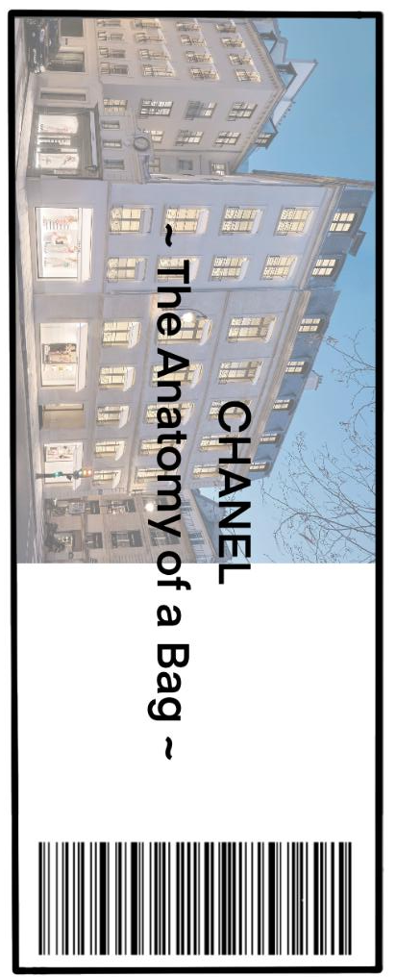
Creative Brief
Now and Forever: The Anatomy of a Bag – product attribute education campaign to increase purchase motivation and dispel pricing concerns
Media Distribution – a campaign that highlights the expert craftsmanship and product attributes of the Chanel Classic Handbag – in the vein of Charlie and The Chocolate Factory – social media, print, and video ads leading up to a high class opening up the factory event, where invited influencers will have the opportunity to experience Chanel creative and manufacturing processes.

Slide 16
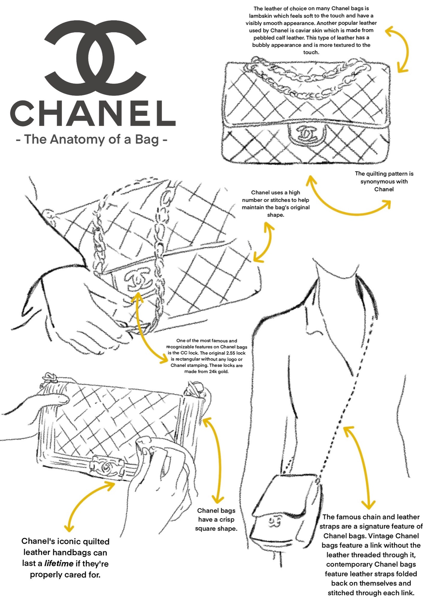
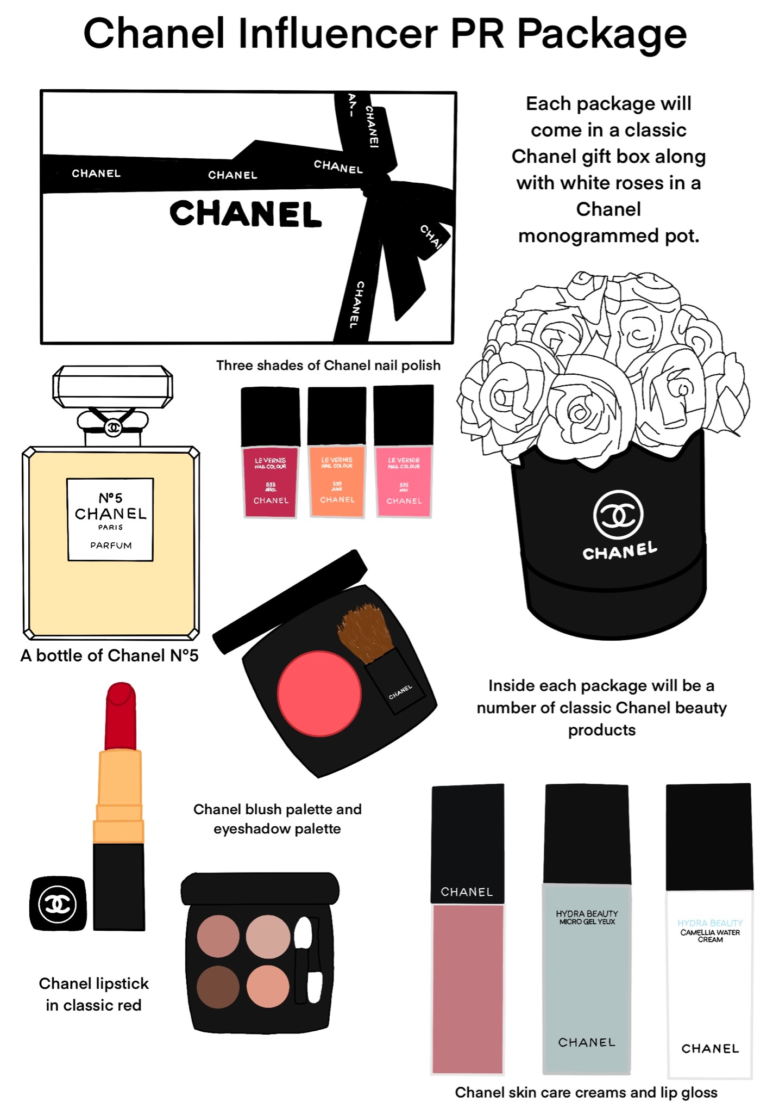

Slide 17
Creative Brief
Target Audience
While the Chanel target audience includes all genders, but because of the highlighting of handbags, we are looking to reach women, ages 28-65, who are within the top percentage of wealth.
The Campaign will target largely urban or suburban women, who are interested in fashion influencers, signifying class and power with clothing, and exclusivity
Audience persona:
Our audience persona would be a female between the ages of 35 and 50. This woman has an annual household income of more than $100,000 and lives in one of the six designated cities identified. For example, New York City, Los Angeles, Chicago, Paris, Milan, and London. She is well-versed in couture and high fashion, spends her free time reading Vogue and other fashion outlets. Reads up on the latest technology of making purses but appreciates handmade work more. She knows what she wants and is eager to get it. Her goal is to spot a limited edition bag on the runway and walk away with it.

Slide 18
Creative Strategy
Key message/Tone and Manner
“Come see the quality for yourself”
Using the manufacturing of the Classic Handbag at the atelier in Paris, we can demonstrate to influencers, who will disseminate the information to the masses, the kind of product attributes that are difficult to get across on online platforms and with traditional media ads. When people see the quality of the leather and fastenings, the masterfulness of the artisans who make the items, and the careful design, they will have a fuller understanding of why Chanel items are the highest expression of luxuriousness and why they have luxury pricing.
‘The Anatomy of a Bag’ campaign will feature how clothing is not the only way to create desire, but that handbags can complement these values of effortless style as well. A bag and piece of clothing from Chanel makes one feel that their inner beauty is amplified through the sheer magnitude that is bold fashion.

Slide 19
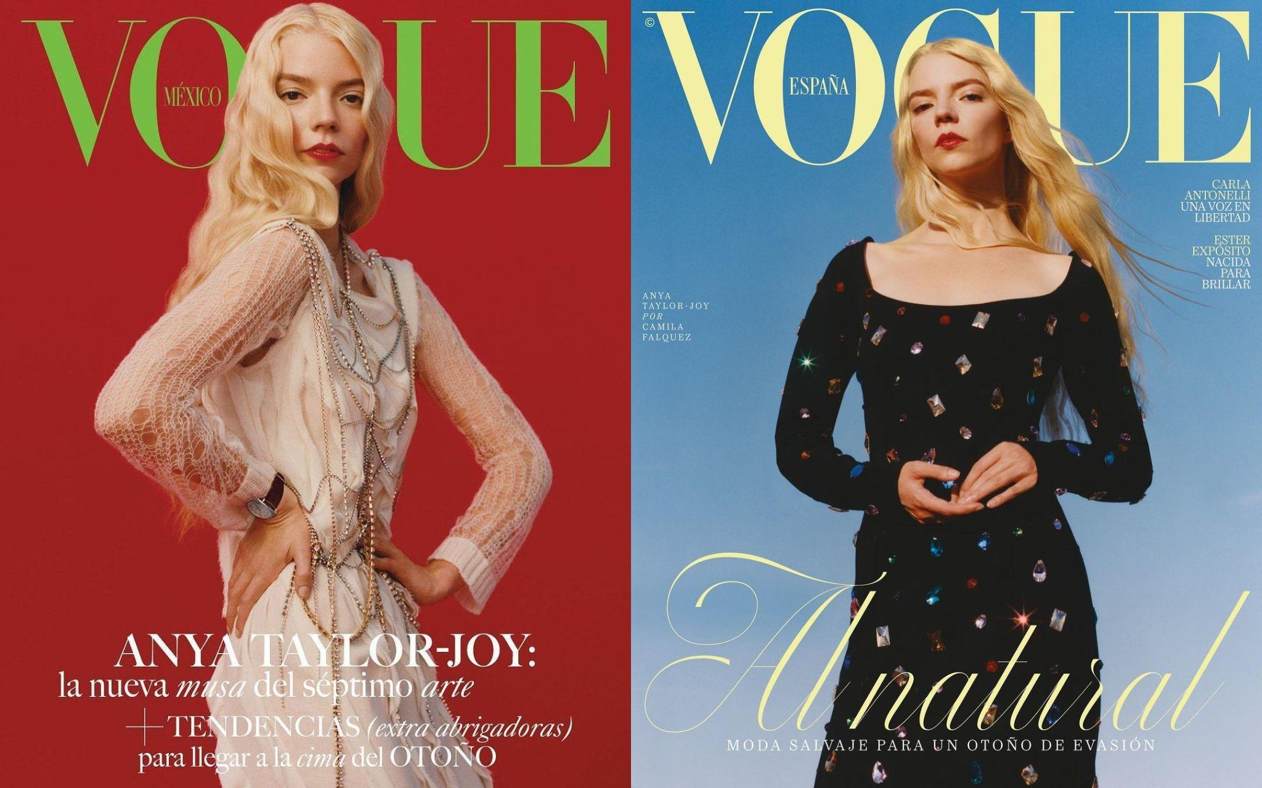
Media Planning Strategy
Paid Media
Social Media
Instagram, Twitter
Ads
Billboard
Magazine
Video
Influencers

Slide 20
When it comes to iconic luxury brands such as chanel, do you prefer seeing a traditional ad or them working with influencers?

Slide 21
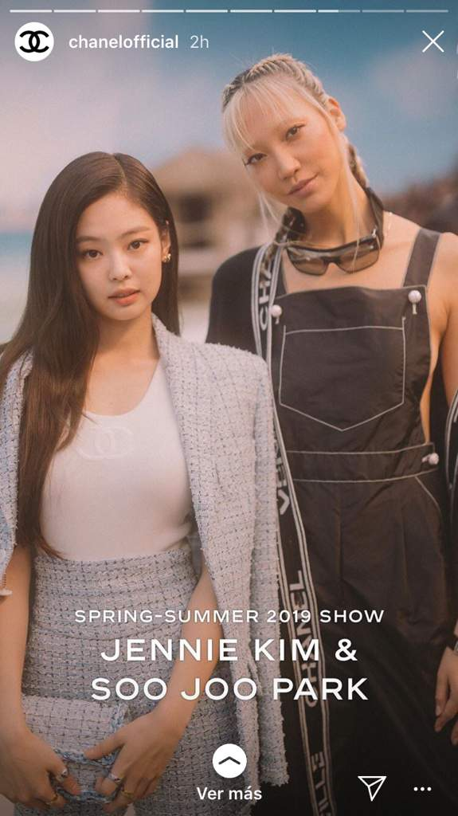
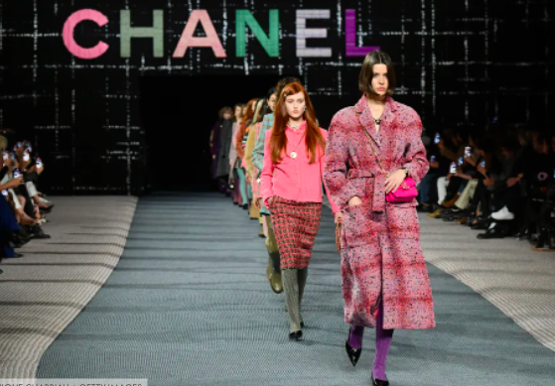
Media Planning Strategy
Building to The Event
45 day campaign, leading up to the spring/summer show
Our media objectives will be to reach 70 % of the target audience
Average frequency of 7
Our 1st phase of the campaign
Content
The 2nd phase focuses on influencer engagement
Excitement
The climax

Slide 22
Media Planning Strategy
Schedule
Magazine Print Ad
Video ad
Shareable Social Media Posts
Magazine Print Ad
Video ad
Shareable Social Media Posts
Influencer PR Packages
Influencer Partnerships
The Event!
Magazine Print Ad
Video ad
Shareable Social Media Posts
Influencer Partnerships
5/5
5/20
6/10
5/1/23
6/18/32
Through lines: Billboard, Influencer Partnerships

Slide 23
THANK YOU.

Slide 24
Citations
Chanel. “Chanel Official Website: Fashion, Fragrance, Beauty, Watches, Fine Jewelry.” CHANEL, https://www.chanel.com/us/.
Guilbault, Laure. “Inside Chanel's Digital Strategy.” Vogue Business, 22 Feb. 2021, https:// www.voguebusiness.com/companies/inside-chanels-digital-strategy.
Hoang, Limei. “Hermès Online Channels Are Booming. Luxury Brands Should Take Note.” Luxury Society - Shaping the Future of Luxury, 25 Aug. 2022, https:// www.luxurysociety.com/en/articles/2020/08/hermes-online-ecommerce-strategy.
Industries, Written by440. “Hermes vs Chanel Case Study – Which Bags Are Worth Investing in Right Now?” 440 Industries – Training For Creative Rockstars, 23 Sept. 2021, https:// 440industries.com/hermes-vs-chanel-case-study-which-bags-are-worth-investing-in- right-now/.
Ni, Yang. “The Brand Analysis of Chanel - Francis Academic Press.” Francispress.com, https:// francis-press.com/uploads/papers/ KZLzoC86240TrOyMFsmiDnfoYsXacsXhy6Qknd5M.pdf.
Song, Vivian. “The French Icon Who Revolutionized Women's Clothes.” BBC Culture, BBC, 1 Feb. 2021, https://www.bbc.com/culture/article/20210201-the-french-icon-who- revolutionised-womens-clothes.

