Slide 1
The Station Grill – Muskegon, MI
Seo analysis
Jake Trygstad

Slide 2
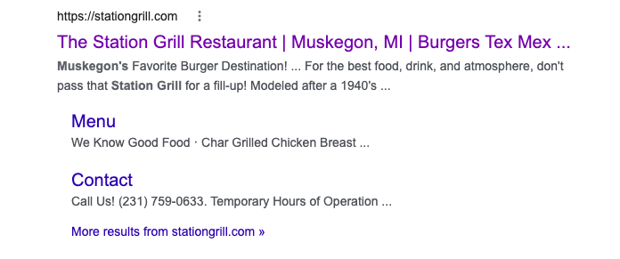
What Do Customers See When Searching for The Station?

Slide 3
SEO – How Can Optimization Improve Traffic
SEO stands for search engine optimization, which is the practice of making your website more compatible with Google (and others) to get your content to the top of the page and keep customers engaged.
One can improve their web traffic by making it easy for the engine to crawl, index, and rank the site, which are industry words for how the engine finds relevant sites.
This can be done by using strategic keywords on your page and including the right tags, alt text or meta-descriptions

Slide 4
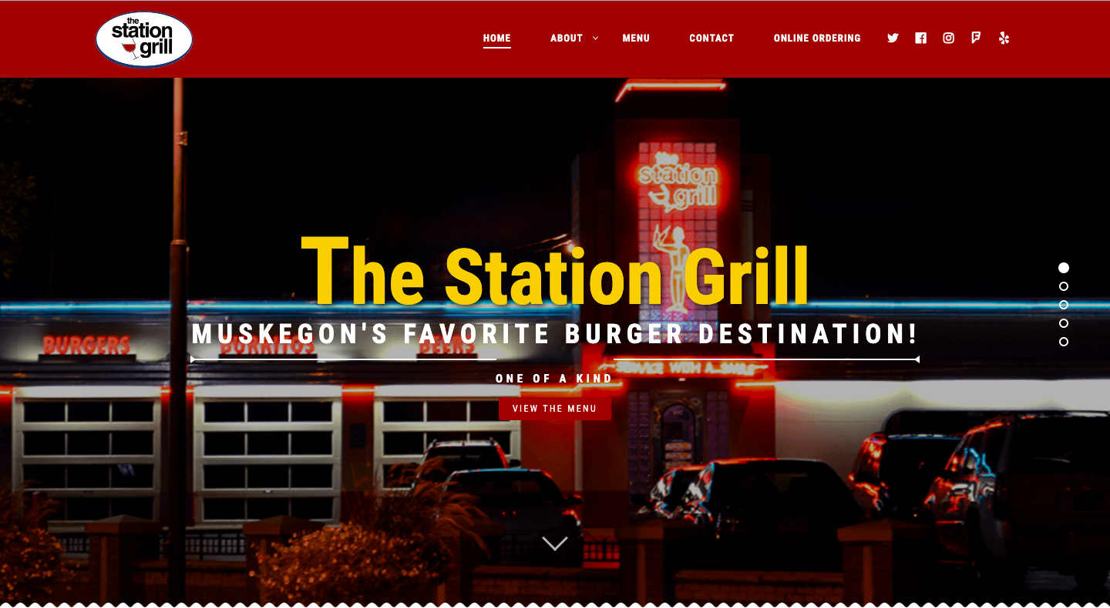
Let's Look at The Home Page – ​​https://stationgrill.com/
The page seems to be optimized for the word “Station”, which is effectively featured in the header and throughout the page
The title is: The Station Grill Restaurant | Muskegon, MI | Burgers Tex Mex Beer – which is a bit longer than is standard
There is no meta description or specified keywords, which is an invisible description that provides search engines with a description of what is on your page so they can index it better
There are no image titles and ⅓ are missing alt text, which help the engine understand the images
24/28 of the links do not have titles, which make it easier for the engine to bring the customer to relevant links

Slide 5
What is Good and What Would I Change
I believe the website has correctly identified its keyword (Station) and have built that word into the site well
I would add meta description and keywords, which will include a concise summary of your page's content. This will help the engine understand what is on your site and bring people to relevant information.
I would add image titles and complete the alt text, which will allow the engine to find your images and show them to people, as well as making your website more accessible.
Lastly, I will add titles to all the link so the engine can understand them – it is great to have links on your site that strengthen the SEO of all of your pages, and the titles will just make it easier to get the customer to relevant pages.

Slide 6
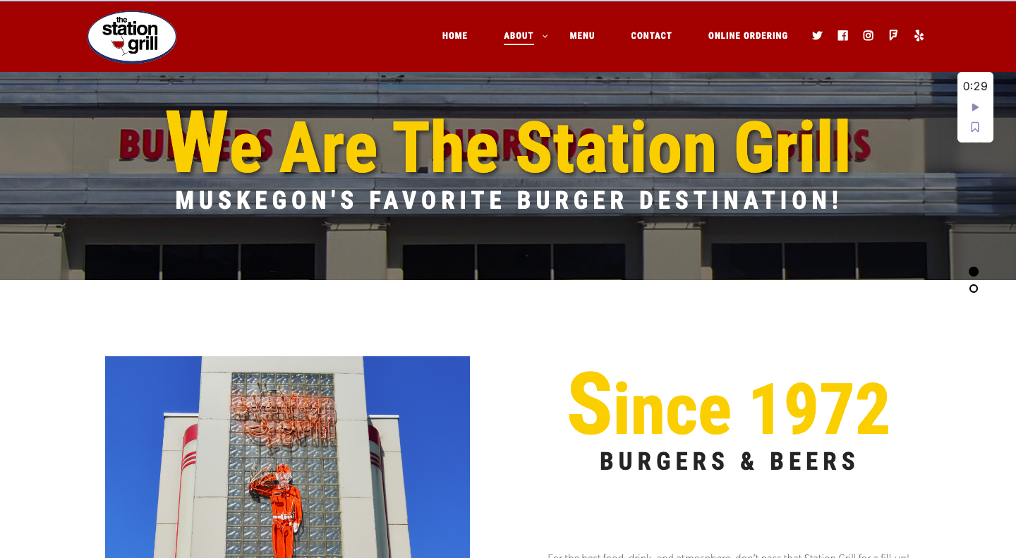
The About Page – https://stationgrill.com/about/
The page seems to optimized for “Station” again, as well as for “beer” and “burgers”
The title is: About - The Station Grill – which is a bit shorter than standard
All images have alt text, but they are missing titles
There is lots of good, relevant text on this page that the customer can engage with and share – especially the employee list, which creates personal, human interest
Again, there is no meta description or specified keywords, which is an invisible description that provides search engines with a description of what is on your page so they can index it better
All of the links on this page do not contain titles, which help the engine determine when it is appropriate to show your image in search

Slide 7
What is Good and What Would I Change, Pt. 2
The site does a great job of providing engaging and relevant text for the engine to use, keeping people on the page and encouraging sharing
I would add more keywords to the title and add titles to the images to increase the likelihood of the engine choosing it
Again, I would add meta description and keywords, which will include a concise summary of your page's content. This will help the engine understand what is on your site and bring people to relevant information.
Having links on your site is a great thing for SEO, soI would add titles to the links to help the engine understand them and assist the customer in navigating to the right page

Slide 8
A Great Opportunity
SEO shouldn’t be feared!!!
It is just a way to turn your owned media into something that brings you new business
If you know how to manipulate it, the internet is a business owner’s best friend.

